Slide 1
Engineering Applications of Machine Learning and Data Analytics
Gregory Ditzler
Dept. of Electrical & Computer Engineering ditzler@email.arizona.edu

Slide 2
Lecture Set Overview
Generating Data
Decision Making with Bayes
Assessing Risk in a Prediction
Reading: Chapter 3

Slide 3
Generating Data

Slide 4
Generating Data

Slide 5
Generating Data
One aspect will encounter in machine learning is benchmarking our algorithms and the data we use in the experiment are very important
Real-world data are the true test to a model’s performance but obtaining such data can be hard and expensive
Synthetic data can provide us a way to “know” the ground truth for data
How should we generate data if we want to do a simple classification problem? What distribution should we use?
What if I want to calculate , or

Slide 6
Example withReal Data

Slide 7
Generating Data
One aspect will encounter in machine learning is benchmarking our algorithms and the data we use in the experiment are very important
Real-world data are the true test to a model’s performance but obtaining such data can be hard and expensive
Synthetic data can provide us a way to “know” the ground truth for data
How should we generate data if we want to do a simple classification problem? What distribution should we use?
What if I want to calculate , or

Slide 8
Gaussian Distribution
Generating multi-variate Gaussian data is one of the most popular ways to generate data.
Let , and then the probability distribution function is given by
where is the determinate of a matrix
Gaussian data are common distribution to generate data
What happens if I want ?

Slide 9
Gaussian Distribution
Generating multi-variate Gaussian data is one of the most popular ways to generate data.
Let , and then the probability distribution function is given by
where is the determinate of a matrix
Gaussian data are common distribution to generate data
What happens if I want ?

Slide 10
Gaussian Distribution
Generating multi-variate Gaussian data is one of the most popular ways to generate data.
Let , and then the probability distribution function is given by
where is the determinate of a matrix
Gaussian data are common distribution to generate data
What happens if I want ?
Notes:
p(\mathbf{x}) = \frac {1}{(2\pi)^{d/2} | \Sigma | ^{1/2}}\exp\left[ - \frac{1}{2}(\mathbf{x}-\mu)^\textsf{T}\Sigma^{-1} (\mathbf{x}-\mu) \right]

Slide 11
What if I want ?
For a two class problem where each class has a difference mean and variance then we have
Notes:
p(\mathbf{x}|Y_2) = \frac {1}{(2\pi)^{d/2} | \Sigma_2 | ^{1/2}}\exp\left[ - \frac{1}{2}(\mathbf{x}-\mu_2)^\textsf{T}\Sigma_2^{-1} (\mathbf{x}-\mu_2) \right]

Slide 12
Visualizing the PDF of a 2D Gaussian

Slide 13
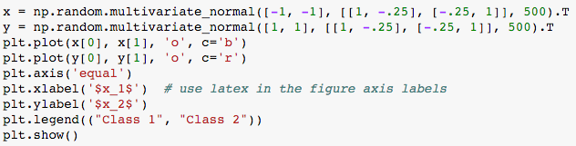
Generating Data from Probability Distributions

Slide 14
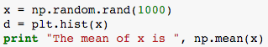
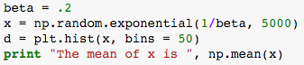
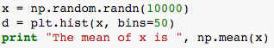
Generating Data from Probability Distributions
Uniform
Exponential
Gaussian

Slide 15
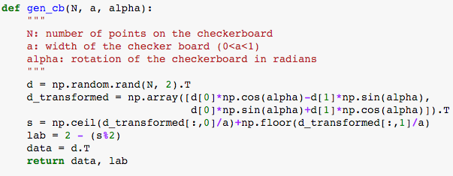
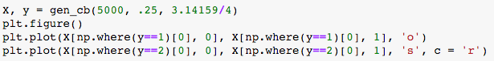
Generating a Checkerboard
In Code

Slide 16
Distance

Slide 17
Distances: With and Without Distributions
Many times throughout the semester we will need to either: (a) measure the size of a vector, or (b) measure the distance between two vectors
Let us first consider a vector with elements xi where i ∈ [p] := {1, . . . , p}. The r-norm is formally given by
This formulation can also be generalized to distances, which the most popular being the Euclidean Distance.

Slide 18
Distances: With and Without Distributions
Many times throughout the semester we will need to either: (a) measure the size of a vector, or (b) measure the distance between two vectors
Let us first consider a vector with elements xi where i ∈ [p] := {1, . . . , p}. The r-norm is formally given by
This formulation can also be generalized to distances, which the most popular being the Euclidean Distance.

Slide 19
Distances: With and Without Distributions
Many times throughout the semester we will need to either: (a) measure the size of a vector, or (b) measure the distance between two vectors
Let us first consider a vector with elements xi where i ∈ [p] := {1, . . . , p}. The r-norm is formally given by
This formulation can also be generalized to distances, which the most popular being the Euclidean Distance.

Slide 20
The Distance Between a Point and Distribution
Those definitions lend themselves well to measuring the distance between two points; however, what if we want to know the “distance” from a point x to a probability distribution?
That point
That distribution

Slide 21
Thinking about it

Slide 22
Mahalanobis Distance
The Gaussian PDF has this distance hidden in the density function. The Mahalanobis Distance is the distance from a point to a distribution. The formal definition of this distance is given by
Note that a point x with “closer” Euclidean distance does not imply a closer Mahalanobis distance with a known μ and Σ

Slide 23
Probability & Bayes

Slide 24
Defining a Probability Distribution
Sample space (Ω): the set of possible outcomes for the random experiment.
Events (F): the set of possible events for the random experiment.
Probability (P): a mass function P : F → [0,1] assigning a number P(A) ∈ [0,1] to each A ∈ F, satisfying the axioms of probability given later in this section.
Laws of Probability
Non-negativity: P(A) ≥ 0 for all A ∈ F.
Additivity: if A, B are disjoint events (A ∩ B = ∅) then P(A ∪ B) = P(A) + P(B). More generally if |Ω| = inf and {A1, A2, . . .} is an infinite sequence of disjoint events, then P (A1 ∪ A2 ∪ · · · ) = P (A1) + P (A2) + · · · .
Normalization: P (Ω) = 1 (something must happen)

Slide 25
Sum Rule
The marginal probability of a single random variable can always be obtained by summing (integrating) the probability density function (pdf) over all values of all other variables. For example,

Slide 26
Product Rule
The joint probability can always be obtained by multiplying the conditional probability (conditioned on one of the variables) with the marginal probability of the conditioned variable.

Slide 27
Bayes Rule
The combination of these two rules gives us Bayes Rule. Let Y denote the outcome that we seek to predict (e.g., healthy or not) and X denote the variable(s) we are provided (e.g., medical records).

Slide 28
Bayes Rule
The combination of these two rules gives us Bayes Rule. Let Y denote the outcome that we seek to predict (e.g., healthy or not) and X denote the variable(s) we are provided (e.g., medical records).

Slide 29
Bayes Rule
The combination of these two rules gives us Bayes Rule. Let Y denote the outcome that we seek to predict (e.g., healthy or not) and X denote the variable(s) we are provided (e.g., medical records).

Slide 30
Visualizing the Posterior and Likelihood

Slide 31
Decisions with Bayes Rule
The Bayes decision rule is the one that minimizes the probability of error or the risk we take when a decision is made.

Slide 32
Visualizing the Probability of Error

Slide 33
Example
My parents have two kids now grown into adults. Obviously there is me, Greg. I was born on a Wednesday. What is the probability that I have a brother? You can assume that P(boy) = P(girl) = 1/2.

Slide 34
Estimating the distributions
What if we do not know the form of the distribution or we cannot determine a closed form?
The simplest estimator of a probability mass function is a histogram.
That is to say if we have a two class problem the we can split the data into each class, we can attempt to model p(x|y ) empirically using the sample that we have.
How much data is enough?

Slide 35
Estimating the distributions
What if we do not know the form of the distribution or we cannot determine a closed form?
The simplest estimator of a probability mass function is a histogram.
That is to say if we have a two class problem the we can split the data into each class, we can attempt to model p(x|y ) empirically using the sample that we have.
How much data is enough?

Slide 36
Example
Let us consider that our advisor told us that we need 30 samples in each bin of the histogram and there are 20 bins.
That means for 1D data: 20 × 30 = 600 instances
That means for 2D data: 20 × 20 × 30 = 12k instances
That means for 3D data: 20 × 20 × 30 = 240k instances
Meet the curse of dimensionality

Slide 37
Example
Let us consider that our advisor told us that we need 30 samples in each bin of the histogram and there are 20 bins.
That means for 1D data: 20 × 30 = 600 instances
That means for 2D data: 20 × 20 × 30 = 12k instances
That means for 3D data: 20 × 20 × 20 × 30 = 240k instances
Meet the curse of dimensionality

Slide 38
Naïve Bayes Rule
Estimating the likelihood terms can be extremely burdensome if we do not know the form of the distribution
Solution: Naïve Bayes assumption. All the features are conditionally independent
The maximum likelihood estimator for P(w)

Slide 39
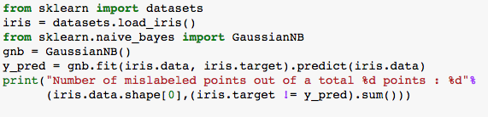
Naïve Bayes in Code

Slide 40
Risk in a Decision

Slide 41
Risk in a Decision
Let us consider the possible class outcomes and the actions that we could consider to even make a decision
We have the class, or the state of nature, for an instance
We have the action that we (the classifier) took
We have a cost with making a decision
The number of actions we could take need not equal the number of classes
An action could be to not take an action

Slide 42
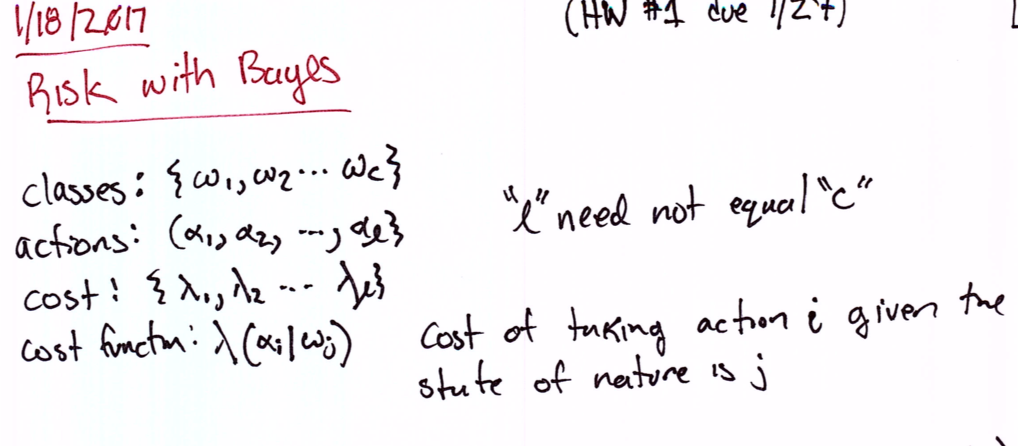

Slide 43
Risk in a Decision

Slide 44
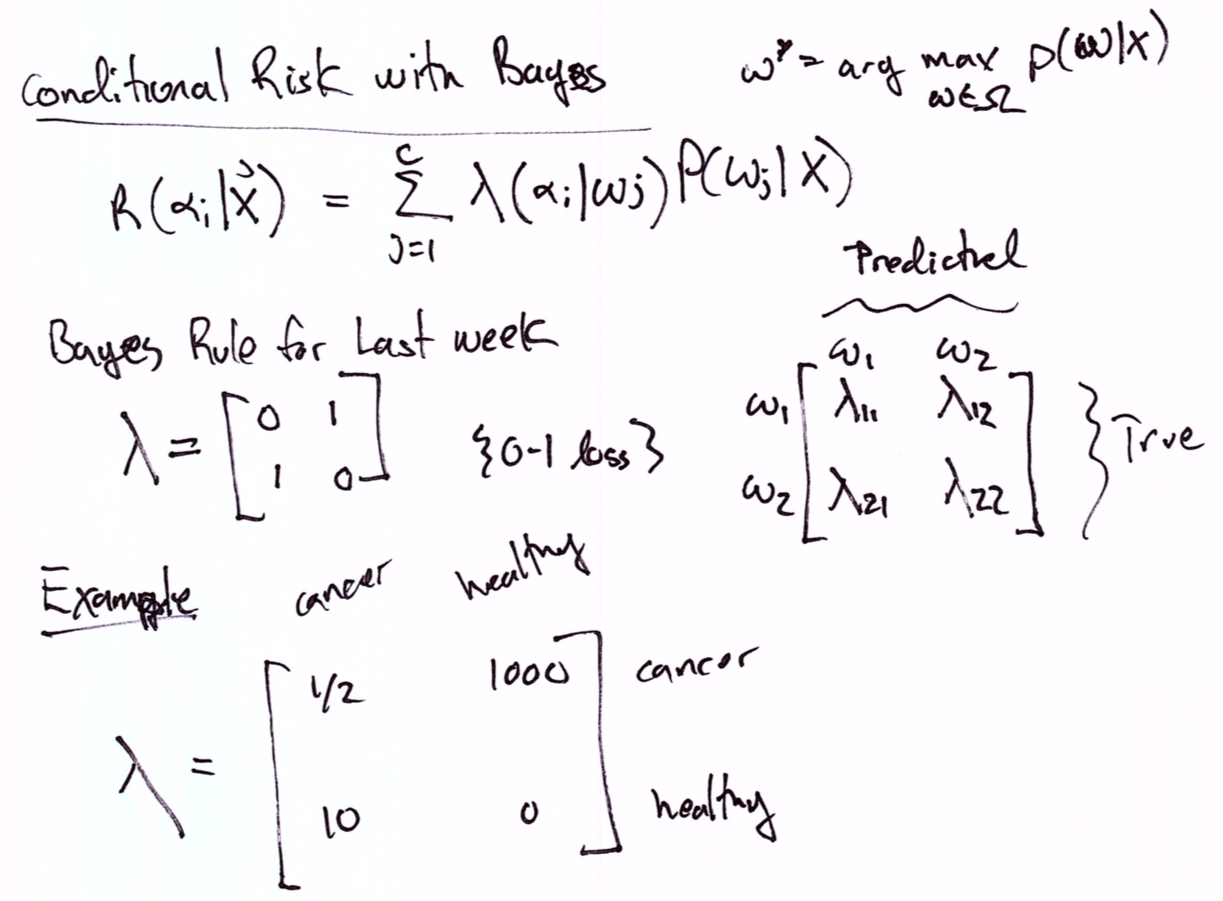

Slide 45
Risk in a Two Outcome Decision

Slide 46
Lecture Set Overview
Generating Data
Decision Making with Bayes
Assessing Risk in a Prediction
Reading: Chapter 3

